Slide 1
HMPO Process Framework
Chris Jarvis
Business Design Authority
Date: August 2016

Slide 2
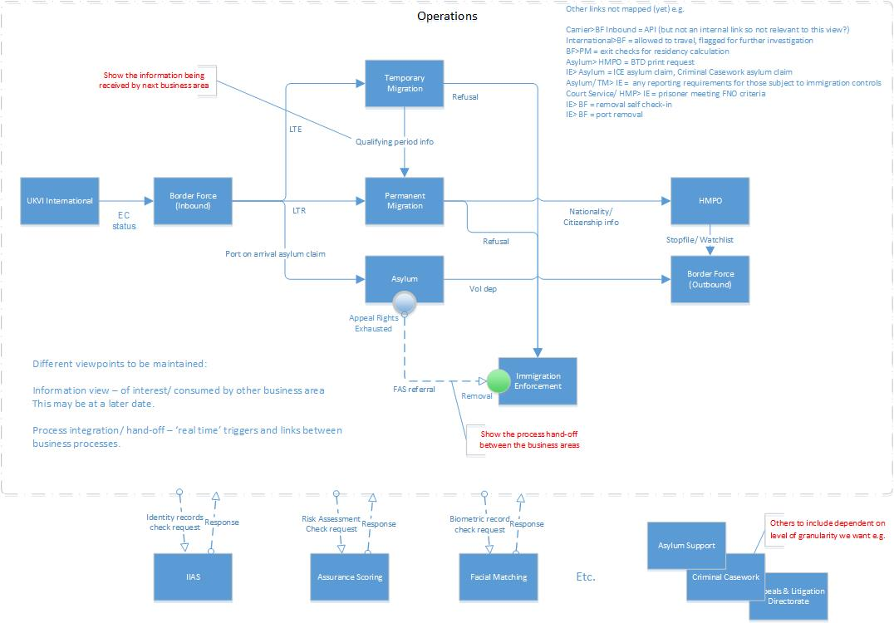
Background – for info BIC view being developed to manage process mapping effort

Slide 3
Purpose of the Process Framework
A logical view of HMPO’s process requirements
Provides the basis for more effective controls for the management of process changes and implementation, and the reduction of variation across business areas and customer groups
Provides a consistent terminology for HMPO
Provides a reference point, for the lower-level design that will be refined and adapted within the projects, driven by business need
Provides a framework for the identification of required IT functionality based on business need, and should be used by projects to ensure that delivery aligns to strategic direction

Slide 4
HMPO Process Framework
PERFORM CHECKS
EXAMINE APPLICATION
(MANAGE INTERVENTION)
MANAGE APPOINTMENT
MANAGE FULFILMENT
REGISTER SERVICE
MANAGE DOCUMENTS
MANAGE INTERVIEW
MANAGE IDENTITY
MANAGE CUSTOMER
MANAGE WORKFLOW
MANAGE MI
MANAGE PAYMENTS

Slide 5
Descriptions
Process/ Activity | Description
Register Service | Online applications and internally initiated activity.
Manage Appointment | Booking, rescheduling or cancellation of an appointment.
Manage Documents | Storage and retrieval of digitised physical documents and electronic documents.
Perform Checks | Management and orchestration of checks to validate information and inform assessment.
Manage Interview | Preparing and conducting interviews, and recording of outcomes.
Examine Application | Application of the legal and business framework and relevant data to support decision-making.
Manage Fulfilment | Creation of products, outputs and notifications. Template management.
Manage Identity | Fixing of an identity, and single view of all information relating to an individual.
Manage Customer | Dealing with customer contact e.g. enquiries, notifications
Manage Workflow | Setting and maintenance of the controls to effectively manage and distribute work.
Manage MI | Provision of reporting and operational management tools.
Manage Payments | Payment receipt, refunds and reconciliation.

Slide 6
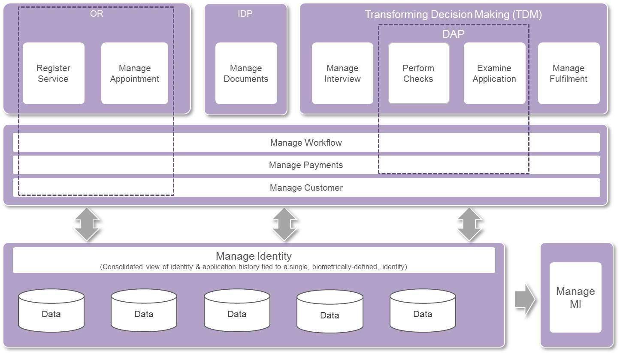
Indicative view of how this gets delivered Current project delivery of services and components

Slide 7
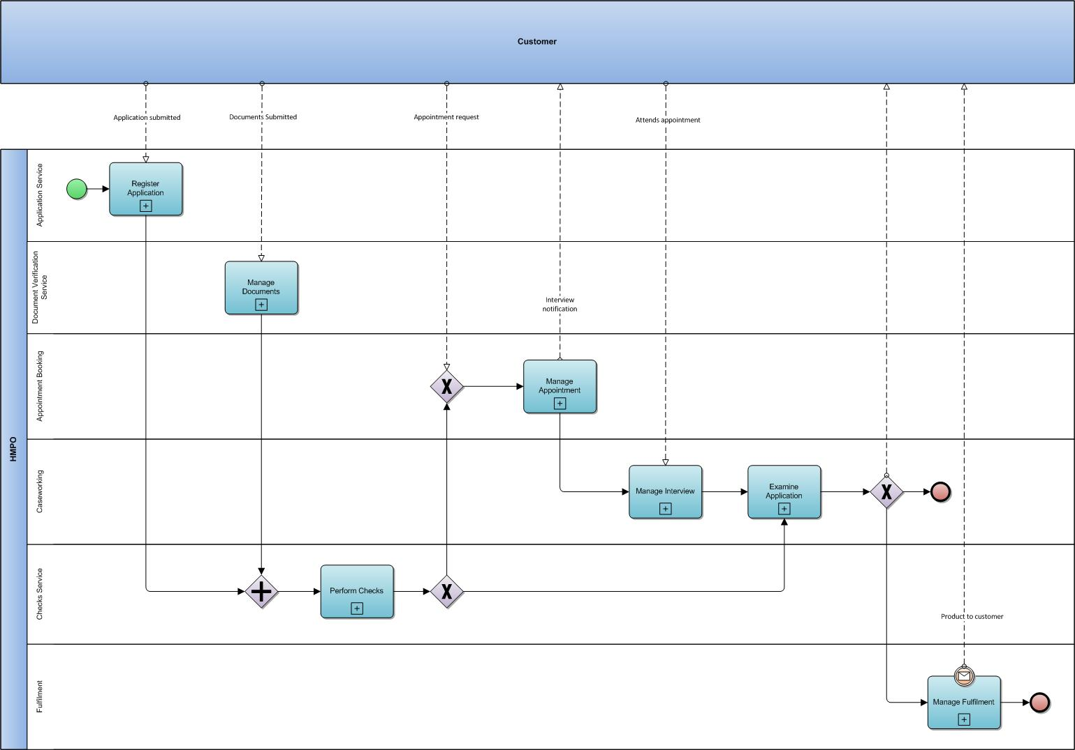
e2e

Slide 8
Register Service
Ability for a customer to access HMPO services:
Applications
Lost/ Stolen notifications
Payment integration
Appointment booking integration
Clearer signposting of required information and document upload
Customer notifications (extensible to support other services)
Ability for HMPO/ 3rd Party to register on behalf of a customer
Creation of a ‘case record’ as the basis for onward processing

Slide 9
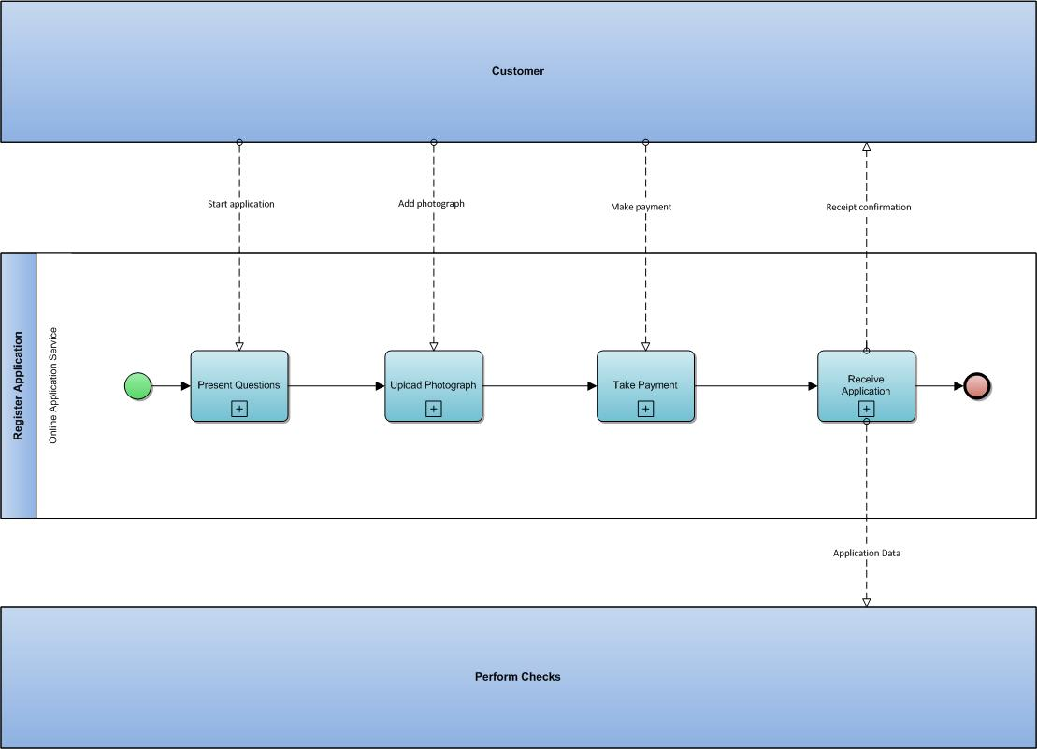
Register Service

Slide 10
Manage Appointment
Ability for customer to book appointments
Display available slots
Confirm appointments
Change appointments
View appointments
Ability for business to book appointment
Send request/ notification
Manage resources and capacity
Estates
Identify required people/ skills

Slide 11
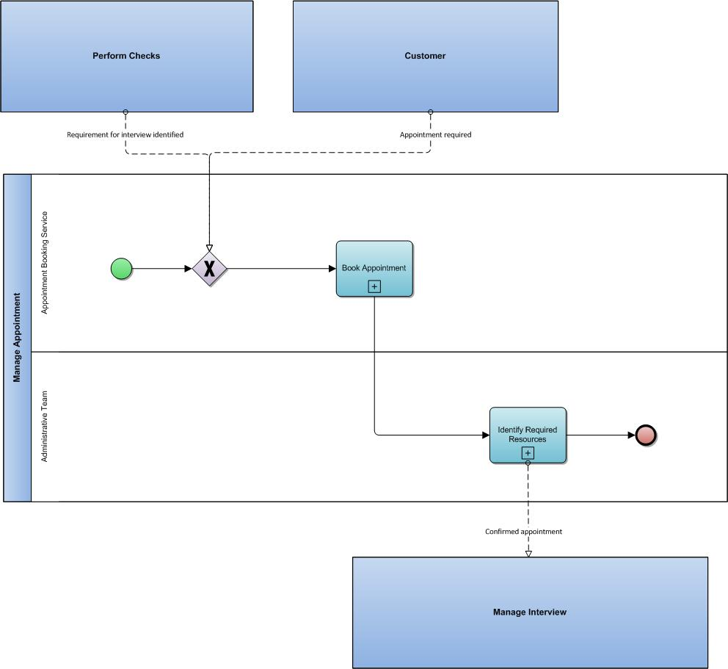
Manage Appointment

Slide 12
Manage Documents
Physical document receipt and scanning
Digital document receipt
Document storage
All electronic documents stored against the individual/ service record
Forgery detection and document verification services
Physical document storage and retrieval

Slide 13
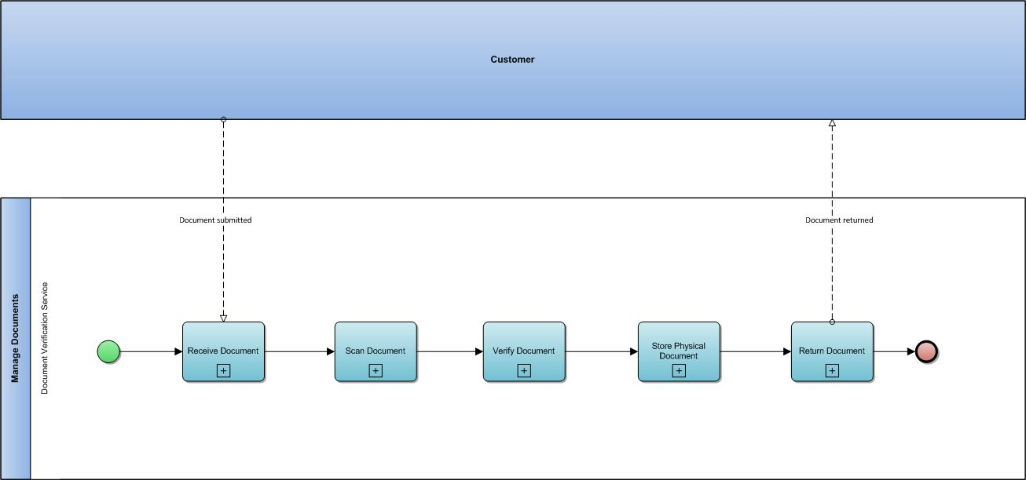
Manage Documents

Slide 14
Perform Checks
GRO data (LEV)
Assurance scoring (HODAC)
Facial Matching (HOB)
Checks against HMPO records/ systems and stop files/ watchlists
Applications streamed based on risk
Enriched data to inform decision making
Application validation
Rules-based identification of gaps in required information
Automatically trigger requests for missing information

Slide 15
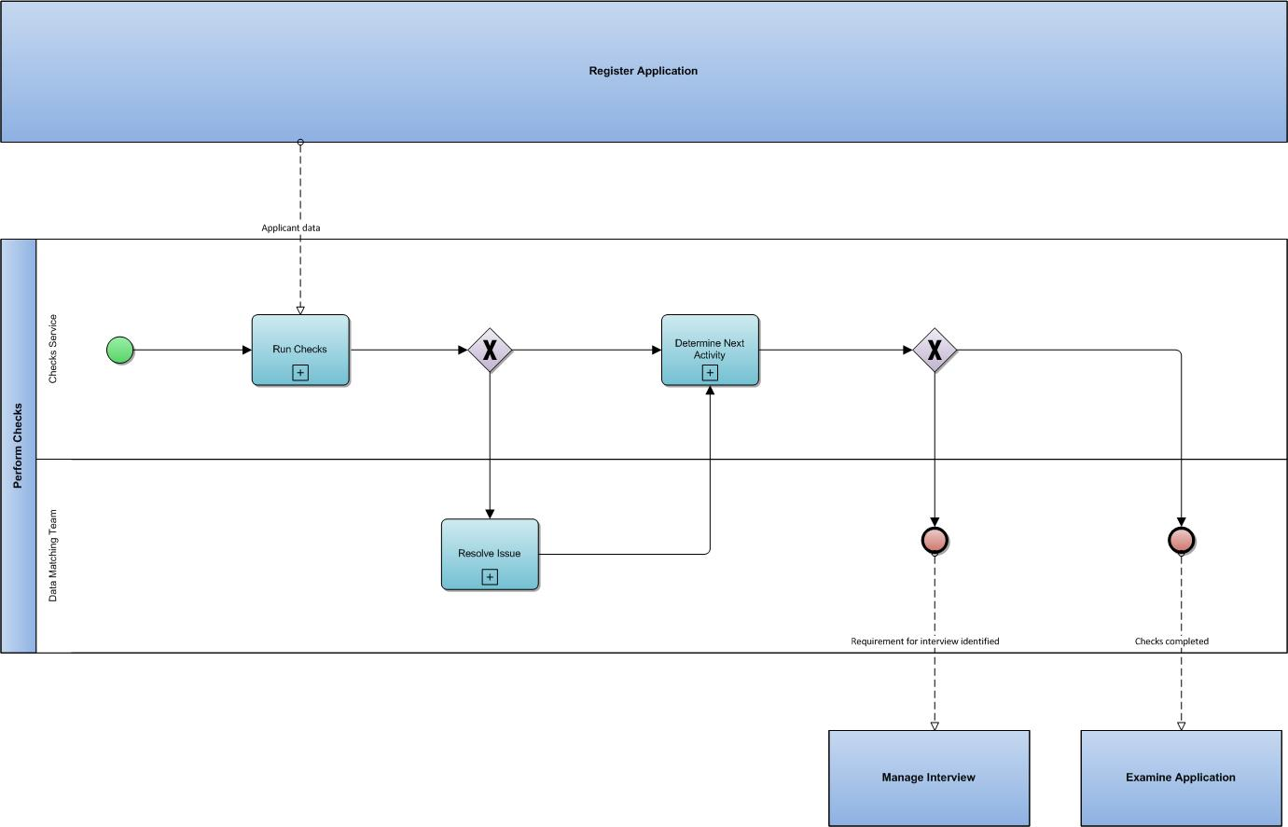
Perform Checks

Slide 16
Manage Interview (BH)
Prepare interview
Conduct interview
Record interview
No record
Audio
Video
Written
Record interview outcomes
Failure to attend
Suspended
Completed
Digitally store transcripts and recordings?

Slide 17
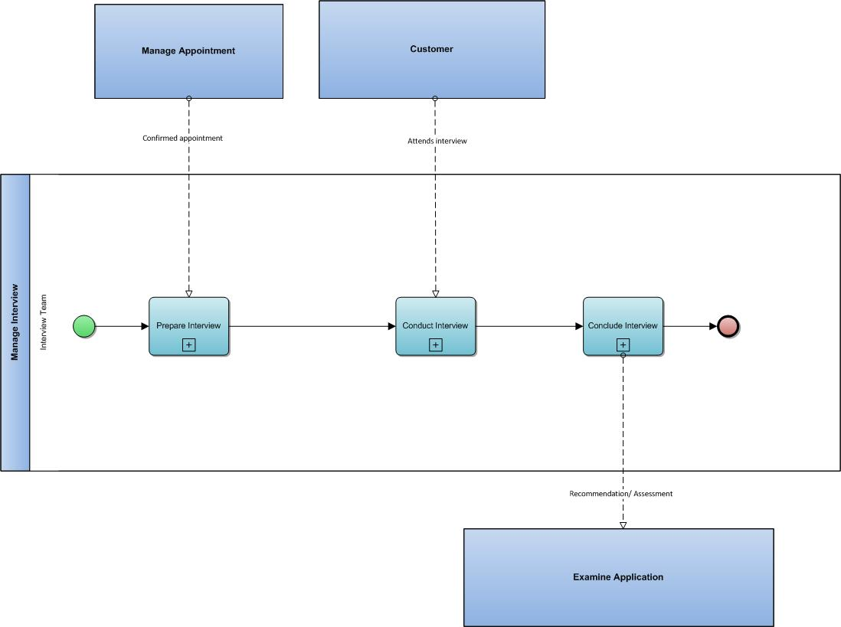
Manage Interview

Slide 18
Examine Application/ Manage Intervention
Structured decision making
All required information presented to the user e.g.
Previous records
Digitised documents
Interview assessment/ recommendations
Driven by business rules, managed and maintained by the business
Decision quality assurance/ review mechanisms
HODAC-delivered services:
Visualisation for FIU
Entity search (fraud investigation)

Slide 19
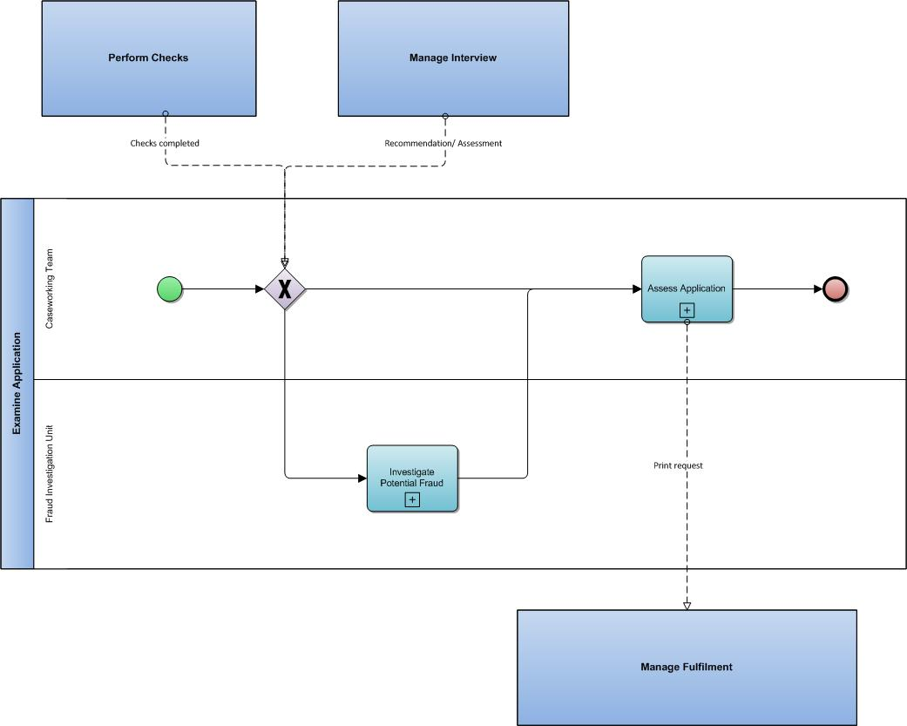
Examine Application

Slide 20
Manage Fulfilment
Covers Production and Despatch/ Delivery
Creation of appropriate decision products or documents
Caters for variety of formats and mechanisms
May be carried out at any location and by a user requested to do so by a task
Interfaces to third parties where responsibility for production sits elsewhere
Recording of any spoiling and destruction, providing an interface to enable management of these activities
Maintenance of a repository of document templates
Customer options:
Secure Delivery
‘Click & Collect’
Priority

Slide 21
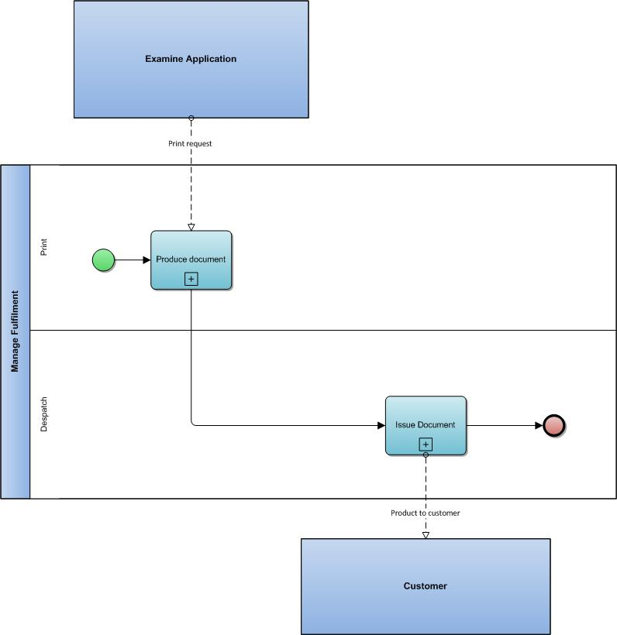
Manage Fulfilment

Slide 22
Manage Identity
Capture and store biographic and biometric data
Record check results
All records are merged to create a person centric view
Single, consistent view of data across systems, reducing data consistency issues
Manage alerts and updates against a person

Slide 23
Manage Customer
Customer Contact
Self-serve
Notifications (extensible from OR service/ GOV.uk Notify)
Assisted Digital offering(s)
Record and retain details of all contact and communications between the HMPO and customer

Slide 24
Manage Workflow
The ability to manage work in accordance with pre-defined business processes
Automatic management of tasks and activities, by applying business rules
Better controls and configuration by appropriate operational users
Clear visibility of all work as it is progressed through the process and no untraceable backlogs
Reduction of work ‘stalled’ in personal work in progress (WIPs) queues
Increased operational flexibility in allocation of work to cross-skilled resources

Slide 25
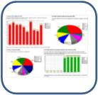
Manage MI - Management Information
Improved MI capability across our systems and processes
Monitoring of performance by user/ role/ task
Real-time activity monitoring
Monitoring and progress tracking on cases/ applications
Better reporting tools, configurable by the user

Slide 26
Manage Payments
Ability to receive payments
Ability to refund payments
Ability to reconcile payments

Slide 27
What’s not a discrete part of process framework?
International
Joint working
Interventions/Fraud?
Intelligence
Counter transformation
Workforce transformation
BDA SPoCs need to collaborate.
Focus is on application processing as core business activity.
Need to consider other aspects e.g.
Data services
Corporate services

